Slide 1

Partnerships
for
Success
Spring Advisory Committee Meeting
tinyurl.com/btmfadvisory611

Slide 2
BTMF Freshman
Financial Literacy

Slide 3

Junior Achievement
Junior Achievement provides students a real-world perspective of finance - one that is current, practical, and easy to understand. Junior Achievement has strengthened its commitment to area students by creating an experiential financial literacy center in the region (Newark, NJ).

Slide 4
Banking and Finance Pathway

Slide 5
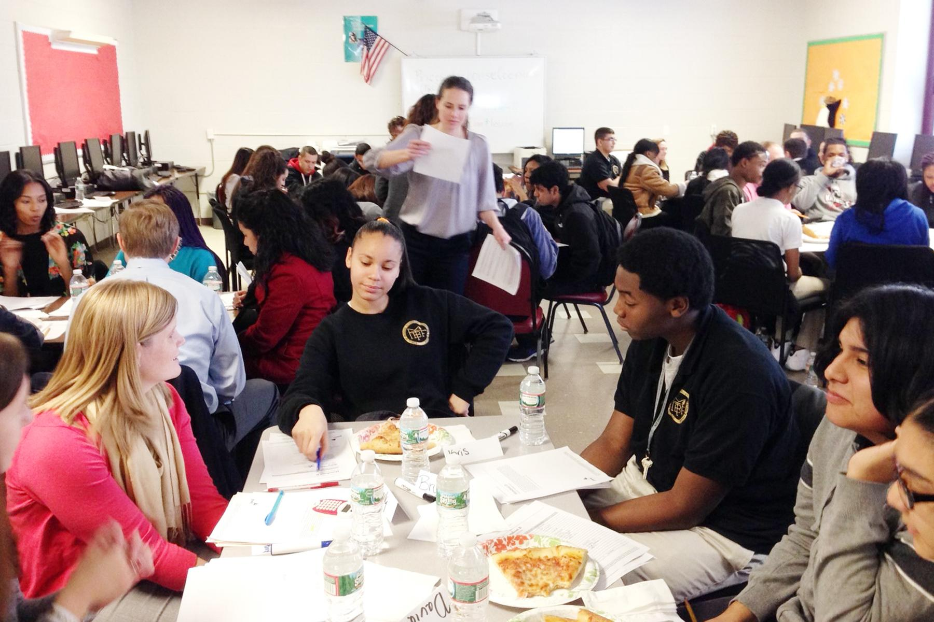

PwC Financial Literacy
Our Accounting students attended 2 workshops on Financial Literacy hosted by Peter Nicolas and his team.
Credit & Debt
Planning & Money Management
Students learned the importance of a positive credit history & the ways that a negative credit report can affect them.
Students also learned how to create a personal budget, including income expenses by developing a financial plan for a family.

Slide 6

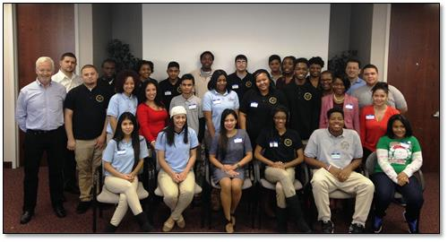

AT&T and Junior Achievement
Job Shadow Program
Accounting I & Accounting II students attended the Aspire Mentoring Day at AT&T’s Premier Customer Service office in Paramus, NJ. This event was organized in conjunction with Junior Achievement.
Students connected with the mentors, learned life skills and diverse career paths, and gained an understanding of how what they learn today connects to their success tomorrow.

Slide 7


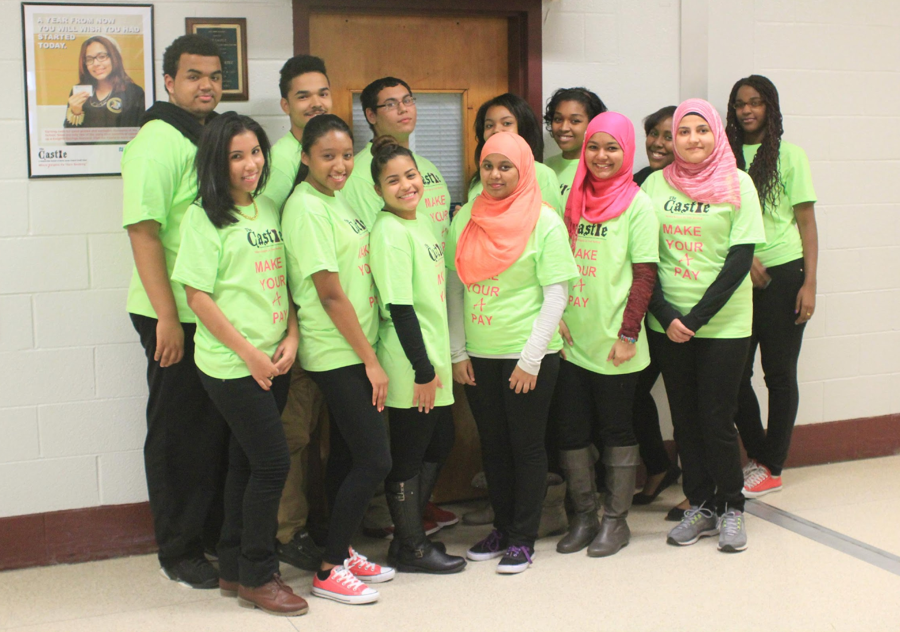
Structured Learning Experience
13 students complete the structured learning experience.
North Jersey Federal Credit Union

Slide 8
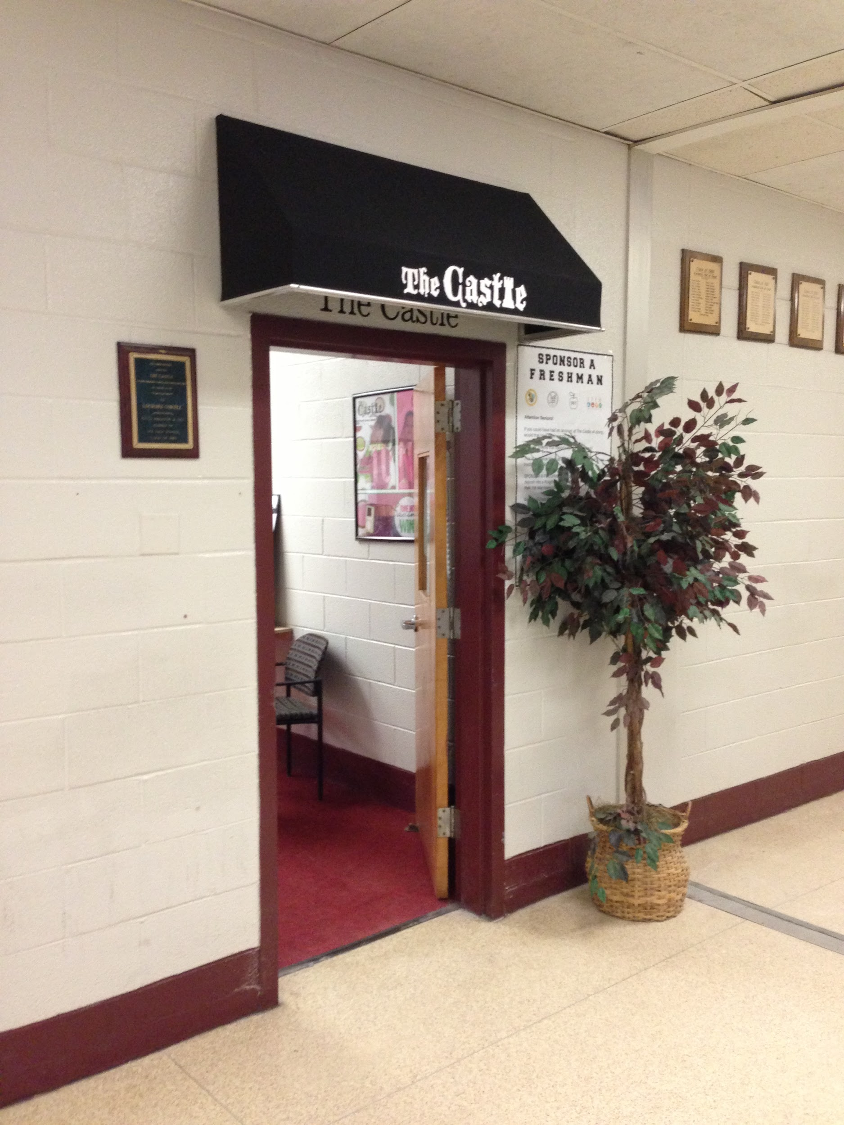
Student Teller Scholarship Award
Taslima Lima
North Jersey Federal Credit Union

Slide 9
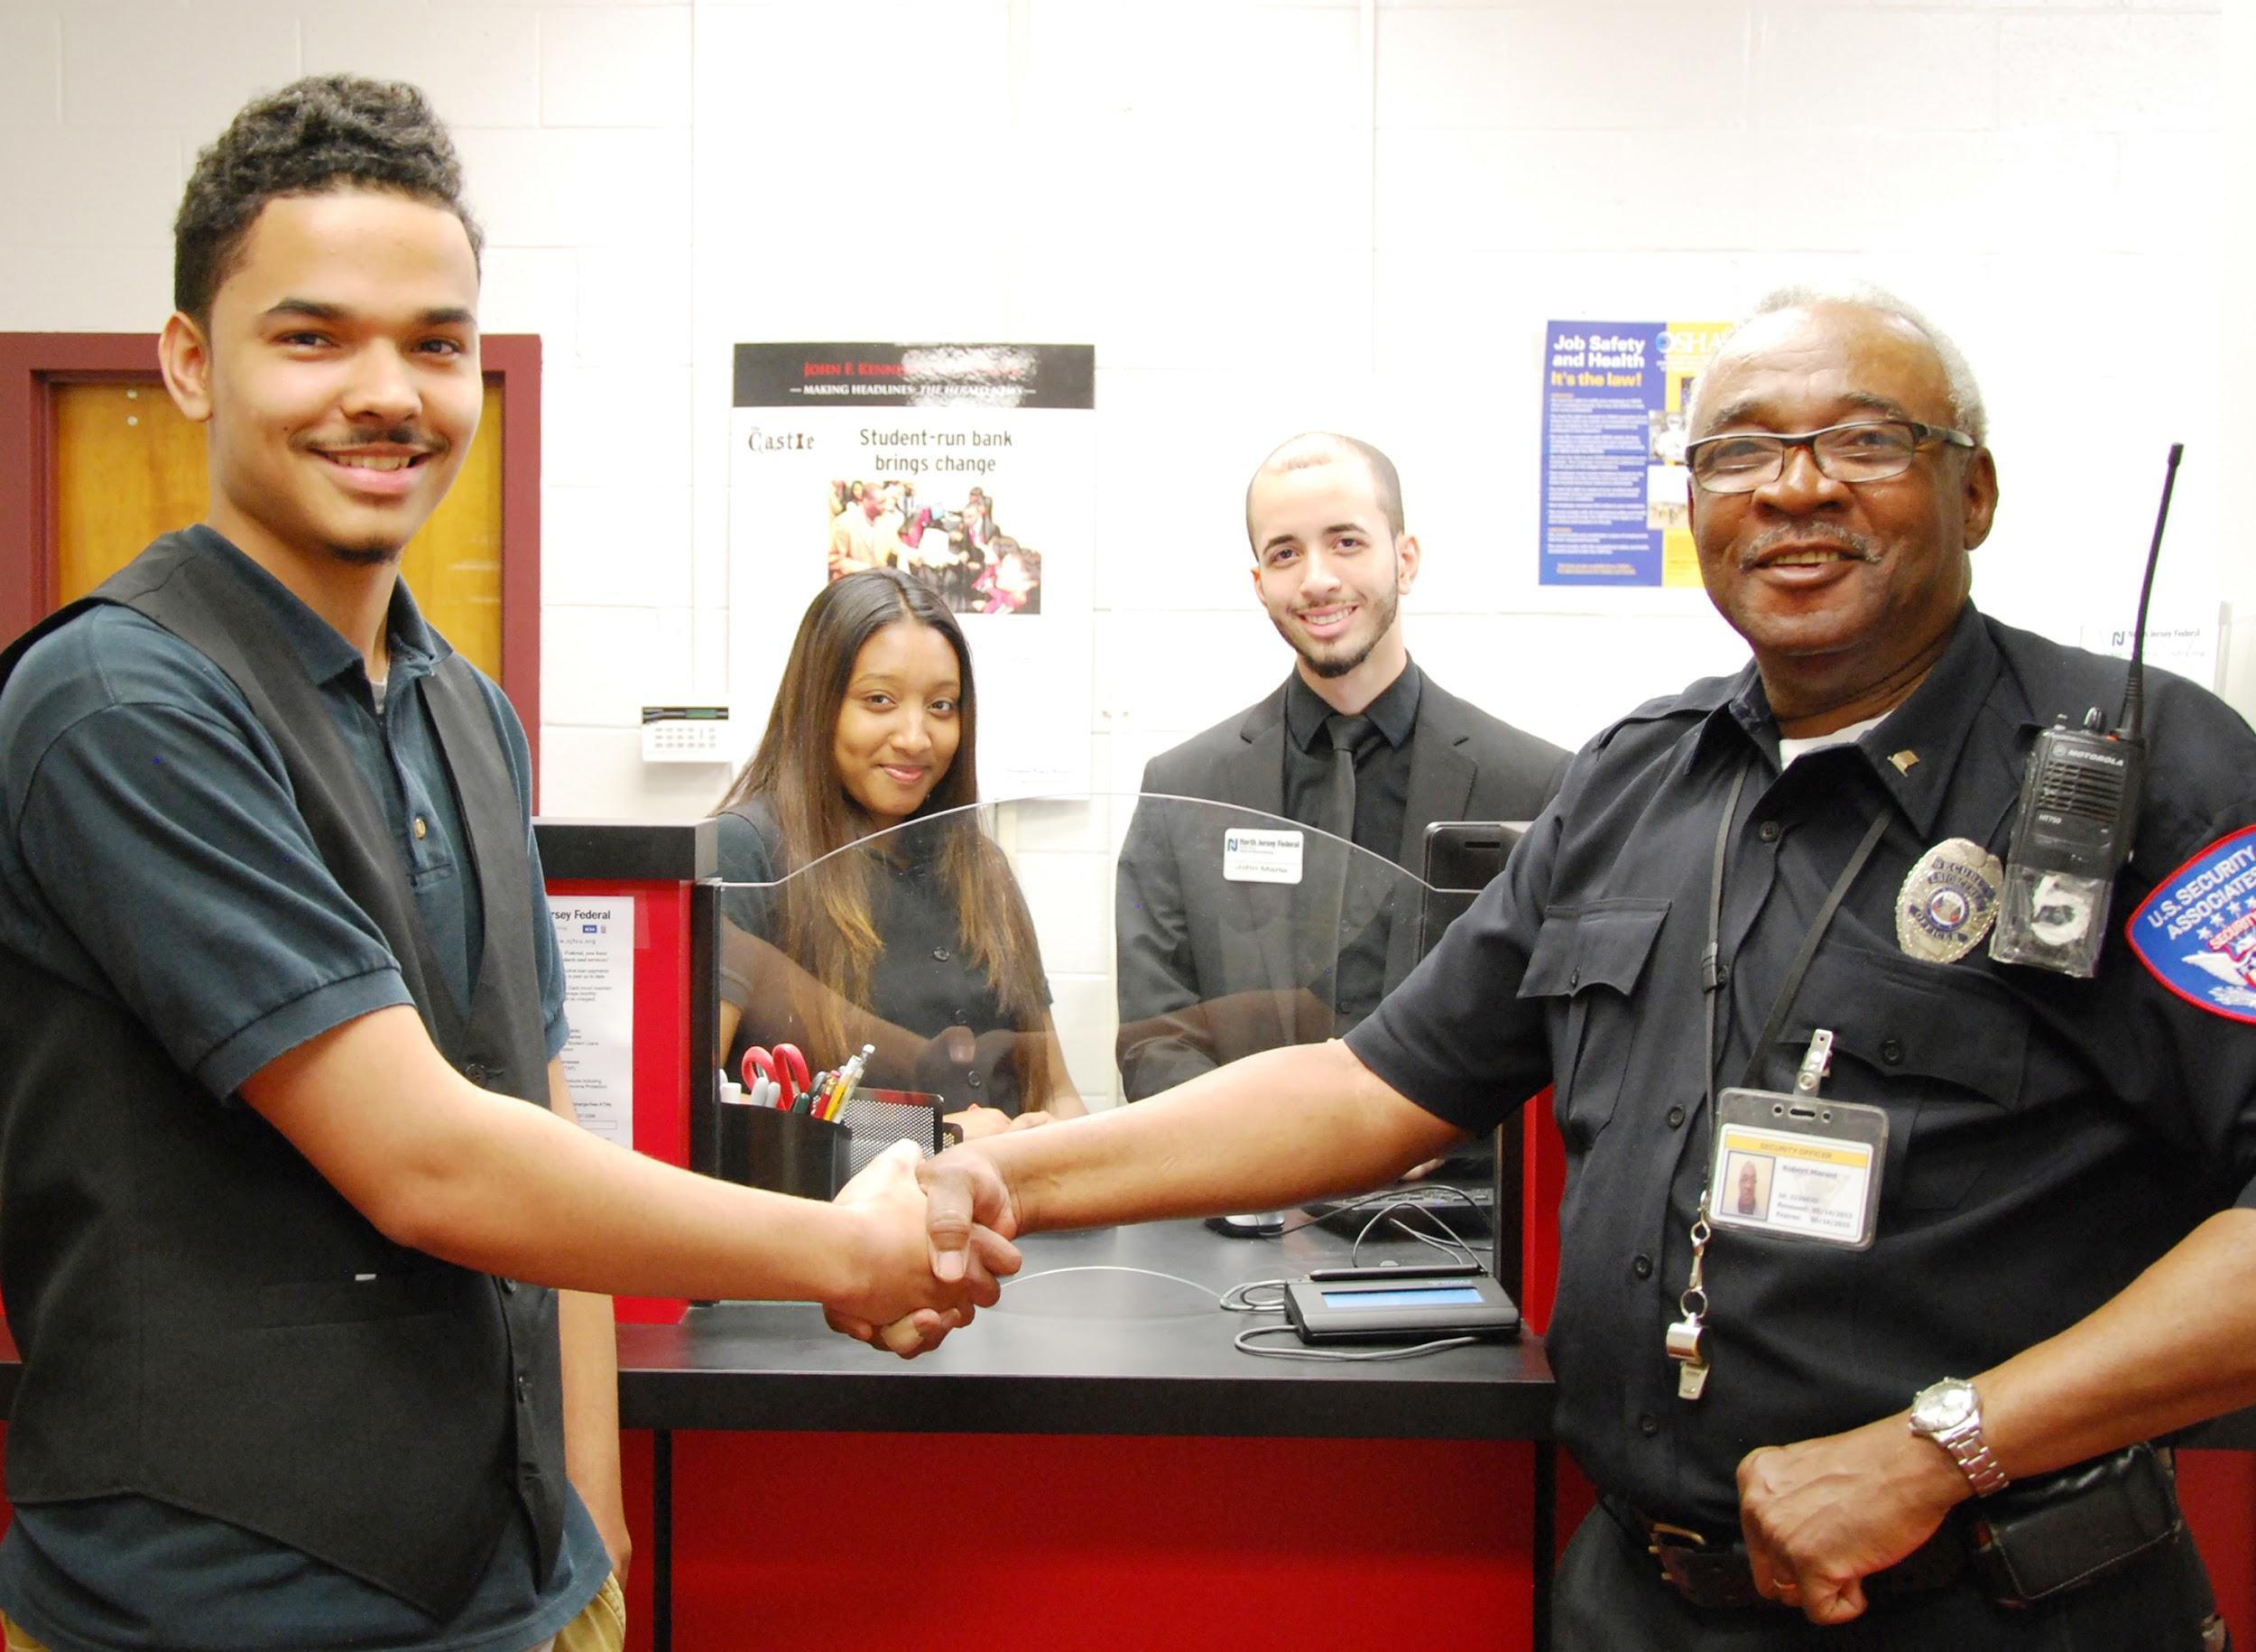
Castle Cares
North Jersey Federal Credit Union

Slide 10
Marketing Pathway
Agenda - http://tinyurl.com/

Slide 11
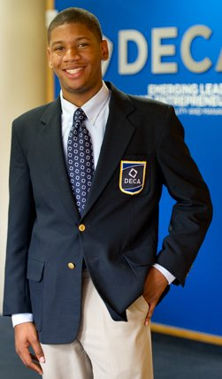
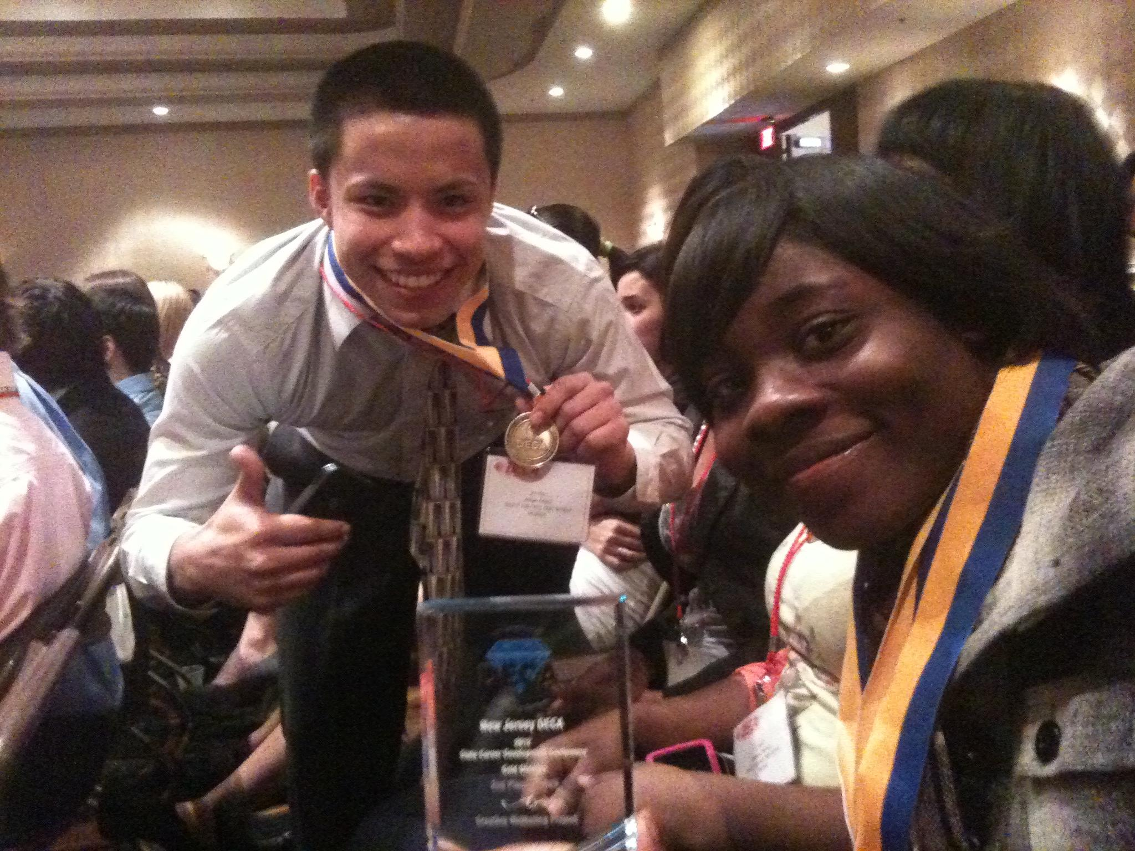
DECA www.deca.org
Current Membership:
50 Students
Our DECA students competed against their peers at the DECA Regional Competition at Ramapo College of New Jersey in January.
Many of these students also completed extensive Marketing plans to attend the State Competition in Cherry Hill, NJ in March. These students were able to learn the value of ‘dressing for success’ and fine-tune their communication and writing skills while being part of the program.
Distributive Education Clubs of America
Notes:
We look forward to continued success!

Slide 12

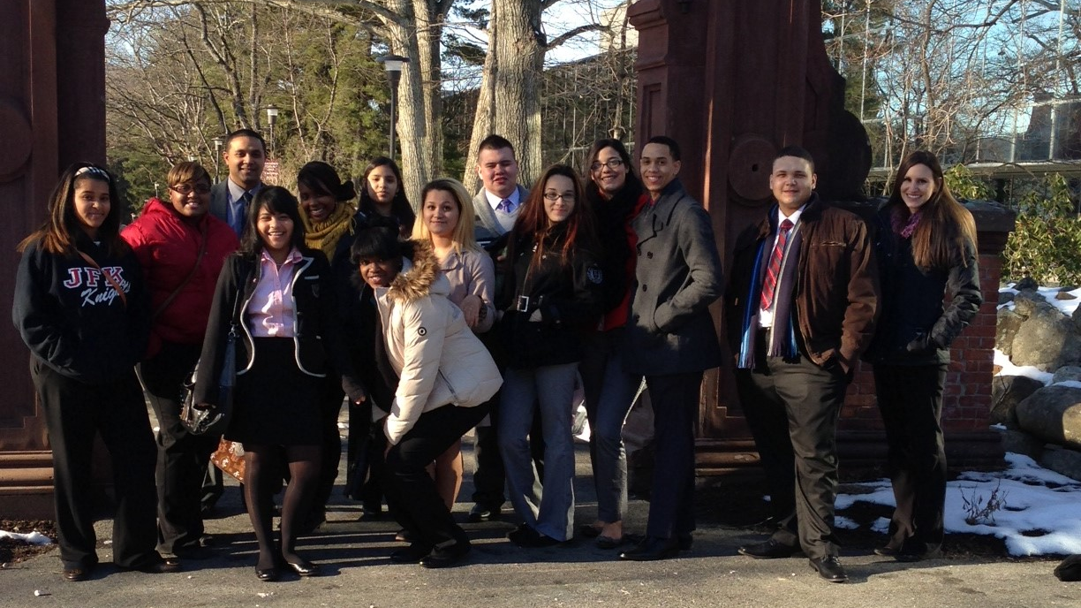
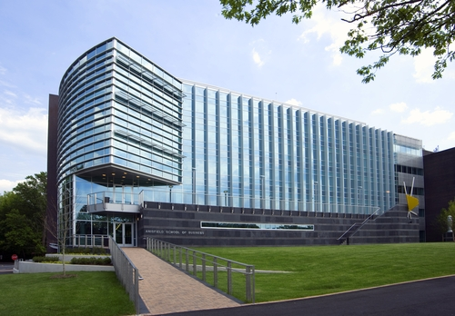
DECA
NORTHERN NJ REGIONAL CONFERENCE, Ramapo College
Distributive Education Clubs of America
Notes:
We look forward to continued success!

Slide 13
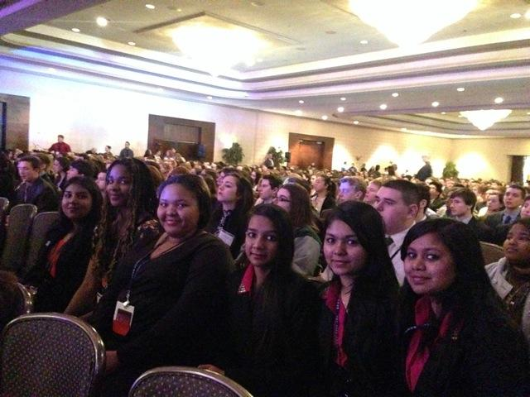
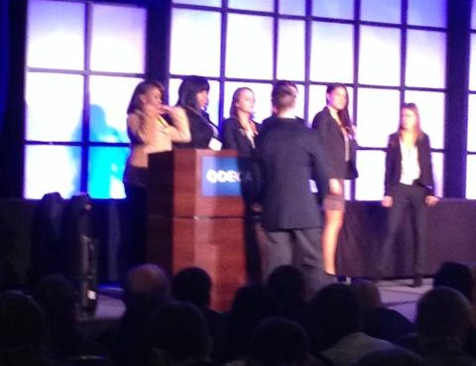
DECA
NJ STATE CAREER DEVELOPMENT CONFERENCE Cherry Hill, NJ
Distributive Education Clubs of America
Notes:
We look forward to continued success!

Slide 14
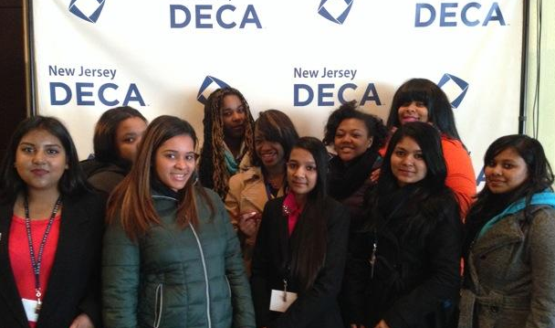
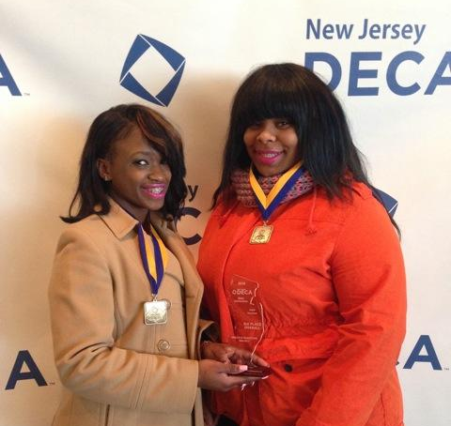
DECA
NJ STATE CAREER DEVELOPMENT CONFERENCE Cherry Hill, NJ
Distributive Education Clubs of America
Notes:
We look forward to continued success!

Slide 15
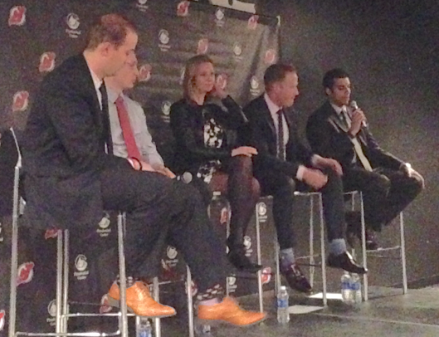
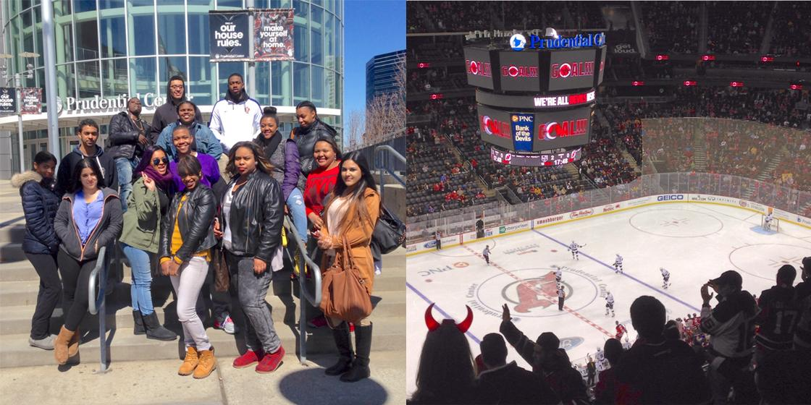
DECA
DECA NIGHT with the NJ DEVILS
Notes:
We look forward to continued success!

Slide 16
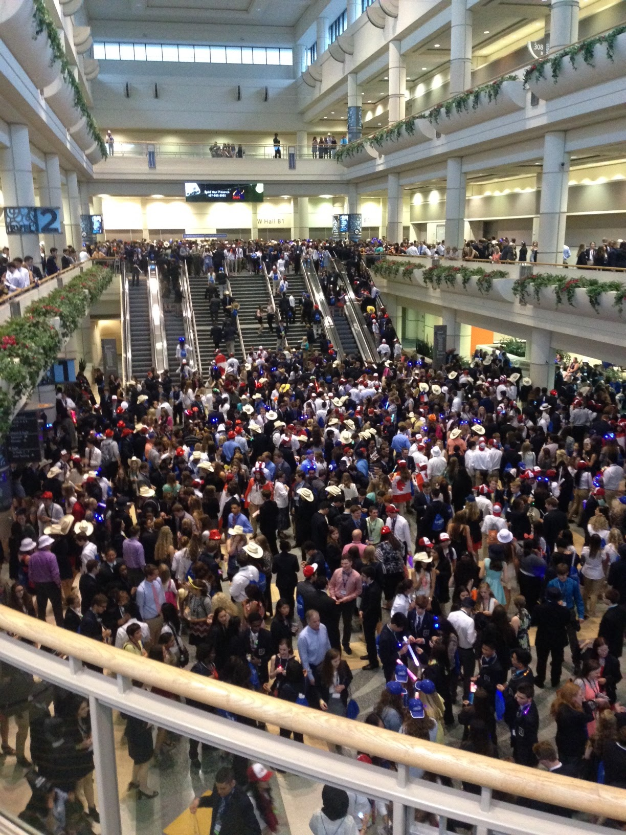
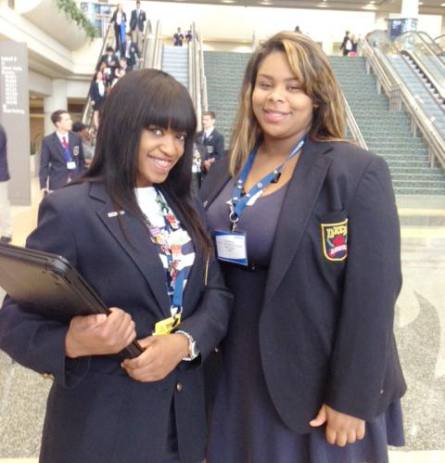
DECA
INTERNATIONAL CAREER DEVELOPMENT CONFERENCE Orlando, FL
Notes:
We look forward to continued success!

Slide 17
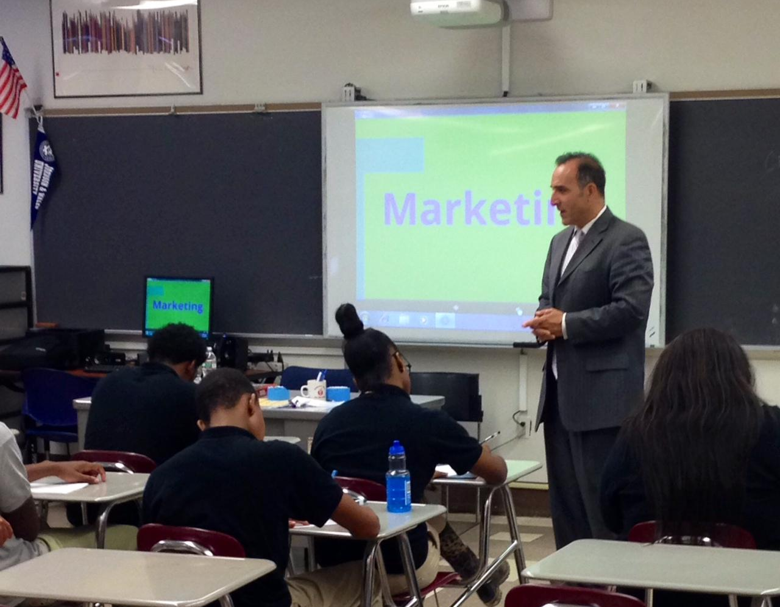
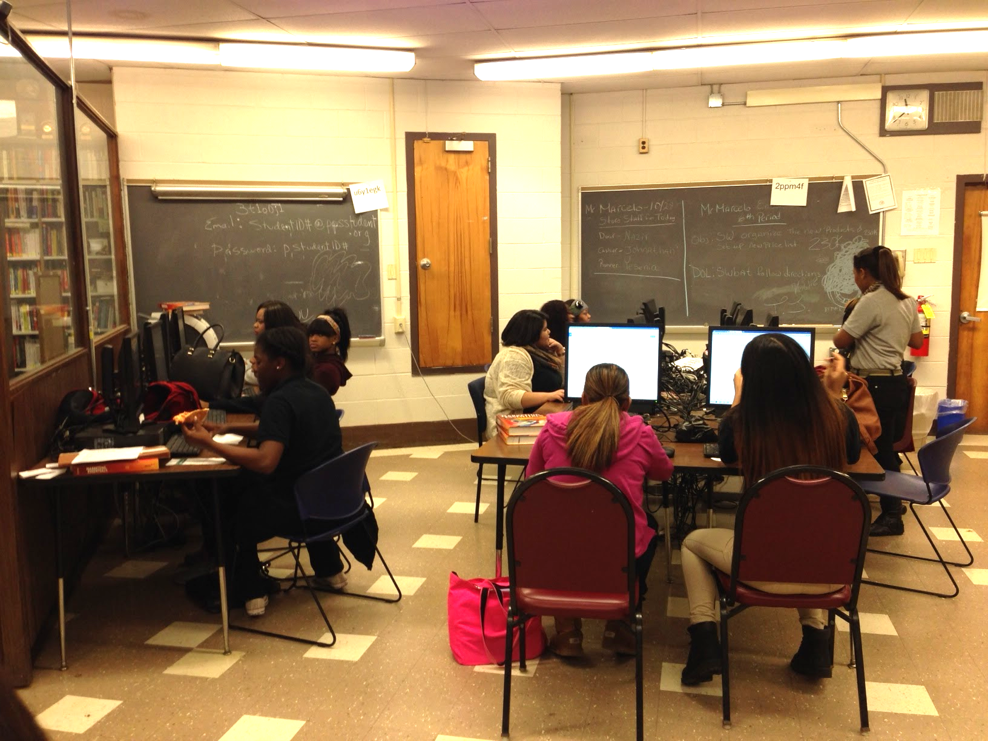
Marketing / Job Training -
Structured Learning Experience
Notes:
We look forward to continued success!

Slide 18









Marketing / Job Training -
Structured Learning Experience
Paterson Education Association
Riviera CHECK CASHING
Notes:
We look forward to continued success!

Slide 19
Business Administration Pathway

Slide 20



FBLA
Future Business Leaders of America
Notes:
We look forward to continued success!

Slide 21

The School of Business, Technology, Marketing and Finance thanks you for your valuable contributions through the year!
2015-2016 School Year

Slide 22

THANK YOU!

