Slide 1

Partnerships
for
Success
Spring 2016 Advisory Committee Meeting

Slide 2
BTMF Vision
Our vision is to be a premier school that is unparalleled in preparing students with the skills to compete in the global business world utilizing 21st century skills.
BTMF fosters an environment which encourages integrity, promotes diversity, and values the purpose and importance of education. We promote the success of all students while respecting the roles of all stakeholders.
BTMF Mission
Our mission is to deliver pedagogy focused on skills and practices relevant to real world business situations. BTMF fosters a positive, safe, and orderly, learning environment which enables students to explore, understand, and build character traits needed to be successful. We will work collaboratively with all stakeholders to ensure academic, social, and vocational success for all students.

Slide 3


Co-Curricular Organizations
Co-curricular organizations provide curriculum-related learning and character building experiences via out of school activities.
DECA - Distributive Education Clubs of America
FBLA - Future Business Leaders of America

Slide 4

DECA - Distributive Education Clubs of America
Advisers: Mrs. Diana Brown and Ms. Martine Grant
www.deca.org

Slide 5
Current Membership:
31 Students
DECA 2015-2016
Twelve DECA Students participated in COLT Conference, a leadership event for students
Seventeen members participated in Regional Competition at Ramapo College in January
Twelve students participated in States Competition in Cherry Hill, NJ
One student,Roberto Collado, received an award for 1st place in a Business Services role play event
Students held a clothing drive for Instituto Ensenanza Ninos Especiales Idene

Slide 6
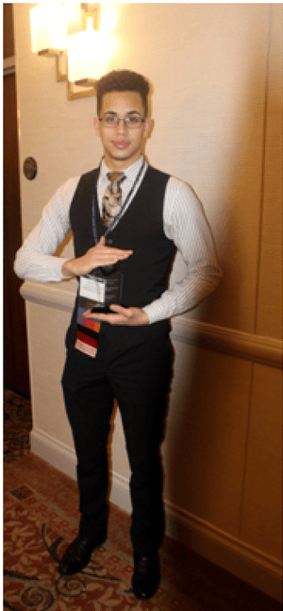
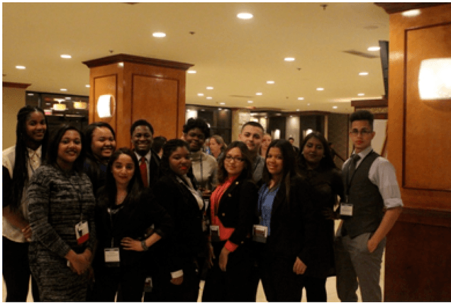
DECA www.deca.org
Current Membership:
31 Students
Distributive Education Clubs of America
Notes:
We look forward to continued success!

Slide 7

FBLA - Future Business Leaders of America
Advisers: Ms. Veronica Mower & Ms. Suzette Brown
www.fbla.org

Slide 8
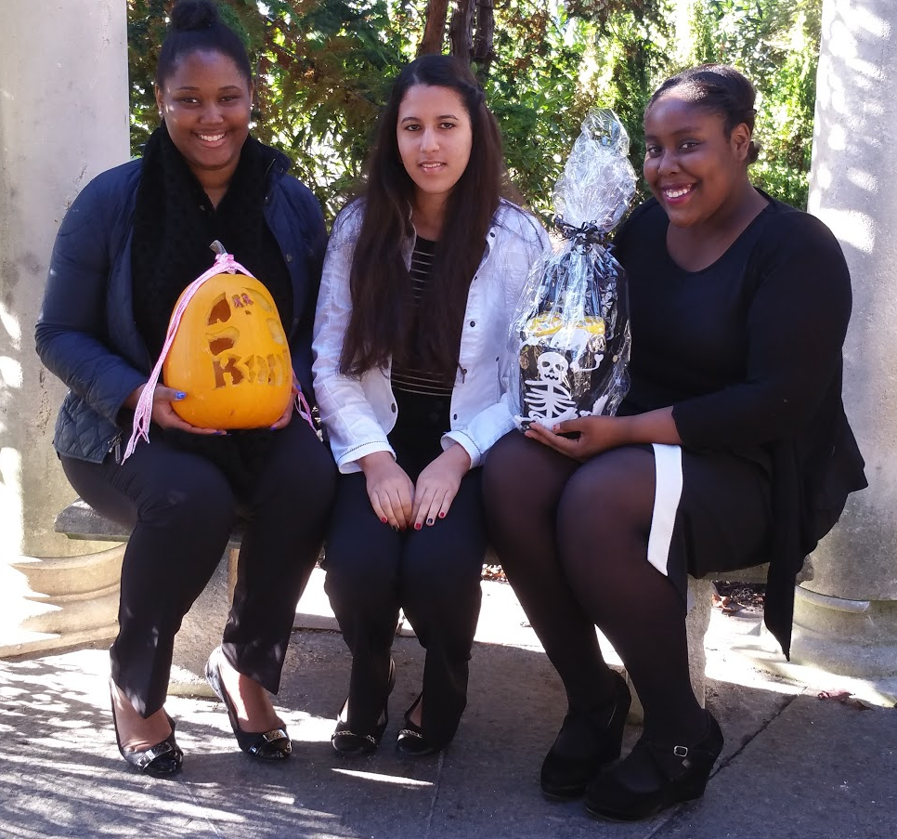
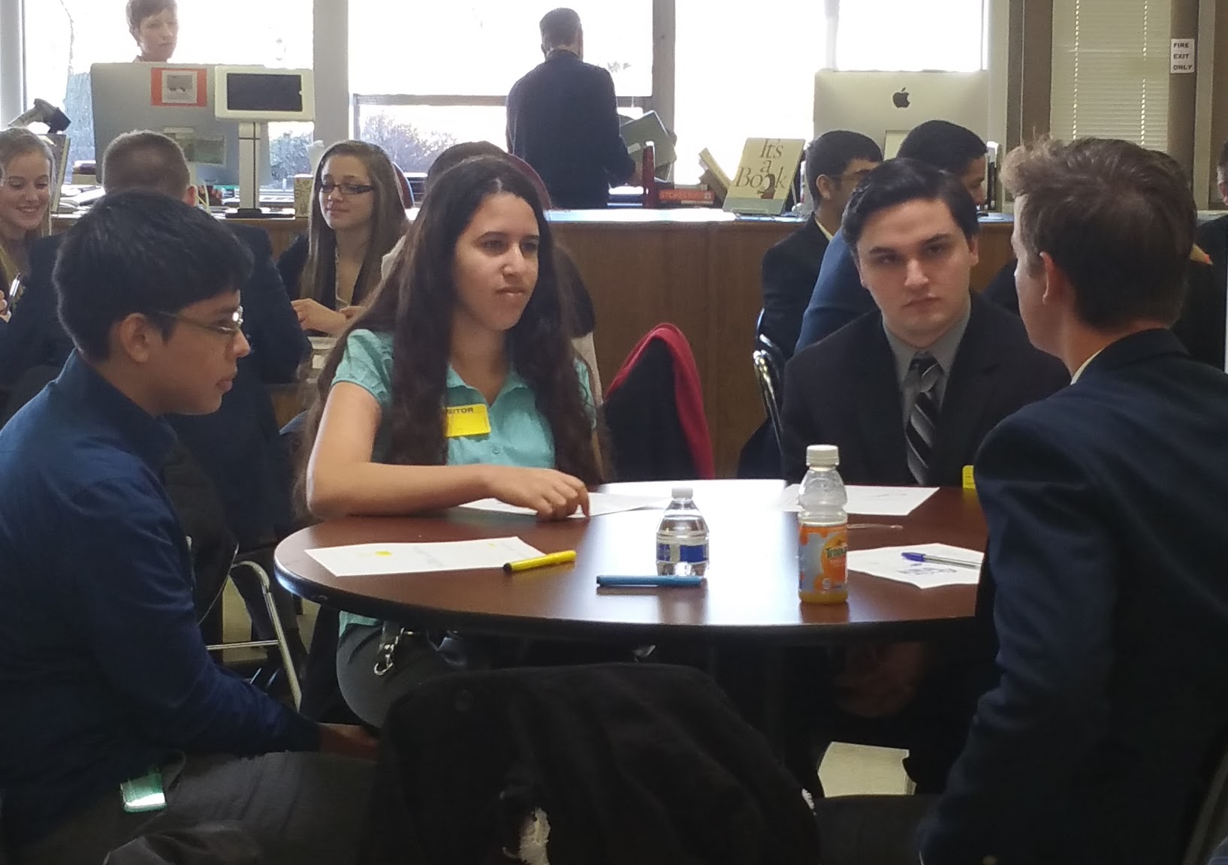
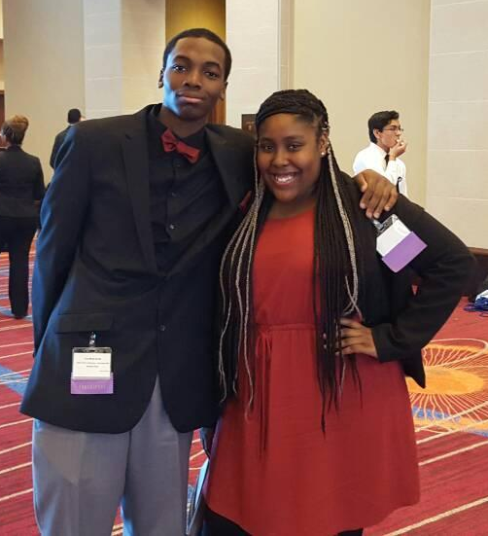
FBLA 2015-2016
3 officers attended Fall Leadership Conference in Edison, NJ
3 members attended the Northern Region Summit at Hanover Park HS
13 members competed at State Leadership Conference in Atlantic City, NJ
  Business Ethics (2 teams)
  Electronic Career Portfolio (Individual)
  Emerging Business Issues (1 team)
  Impromptu Speaking (Individual)
  Web Design (2 teams)

Slide 9
FBLA 2015-2016
32 members
  1 freshman
  16 sophmores
  9 juniors
  6 seniors
2 members earned Community Service Award Community Level (50 hrs.)
  Yeraldine Ochoa
  Ahmet Sonmez
5 members earned Business Achievement Award Future Level (10 activities)
  Maria Bido
  Duneyja Sumter
  Ahmet Somez
  Daylis Foster
  Luis Foster

Slide 10
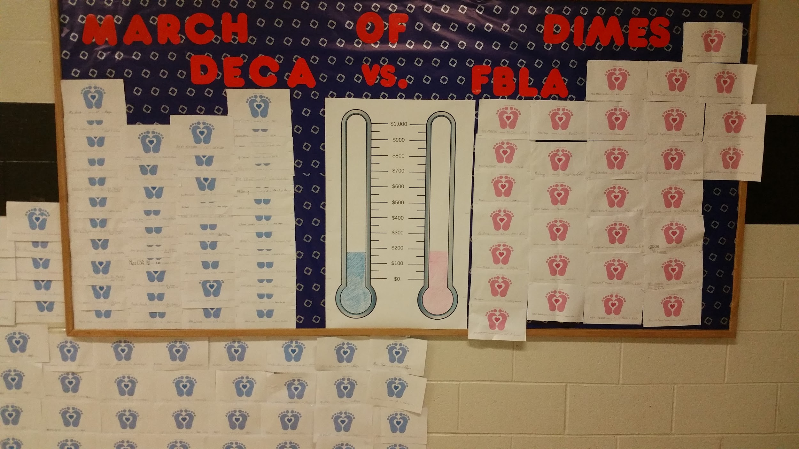
DECA and FBLA Community Service
March for Babies Walk on May 1 at Fairleigh Dickinson University
  Team JFK DECA
  Team FBLA Chapter 7684

Slide 11
DECA and FBLA Expectations
Monthly Officers Expectations
Attend all general meetings (2 per month)
Attend all officer meetings (4 per month)
Attend at least 3 work days (6 per month)
Participate in all Dress for Success Days (4 per month)
Monthly Members Expectations
Attend 1 general meeting
Attend 3 work days
Participate in 1 Dress for Success Day

Slide 12
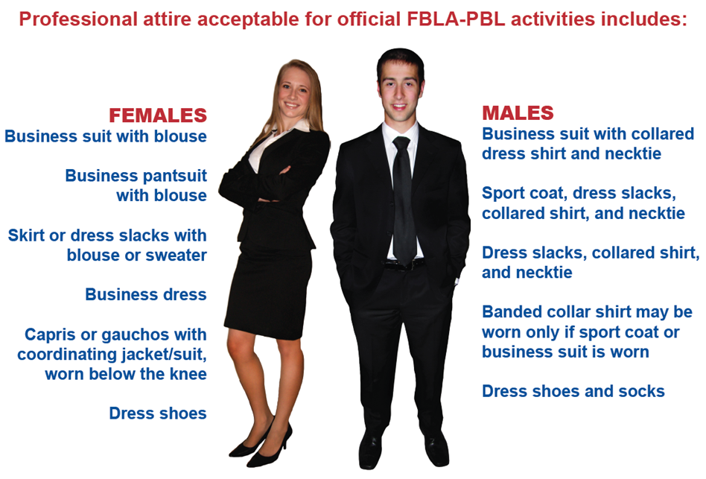
DECA and FBLA Dress For Success Wednesdays

Slide 13

BTMF Business Pathways
1. Business Administration and Management
2. Marketing
3. Banking, Finance, and Accounting
4. Information Technology Applications

Slide 14
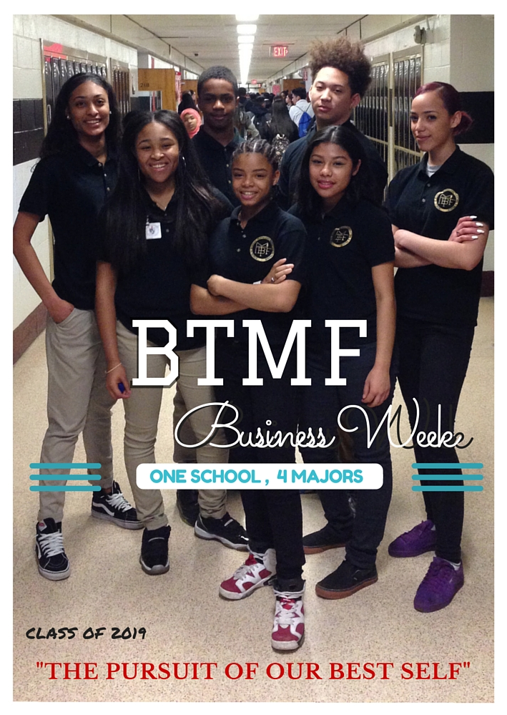
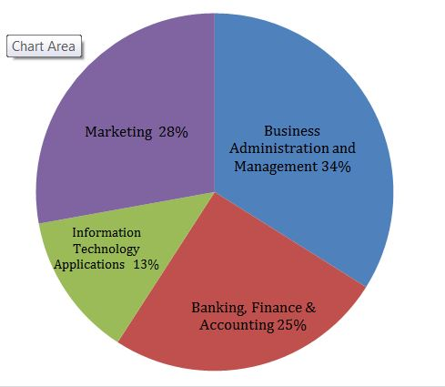
Class of 2019 Pathway Selection

Slide 15
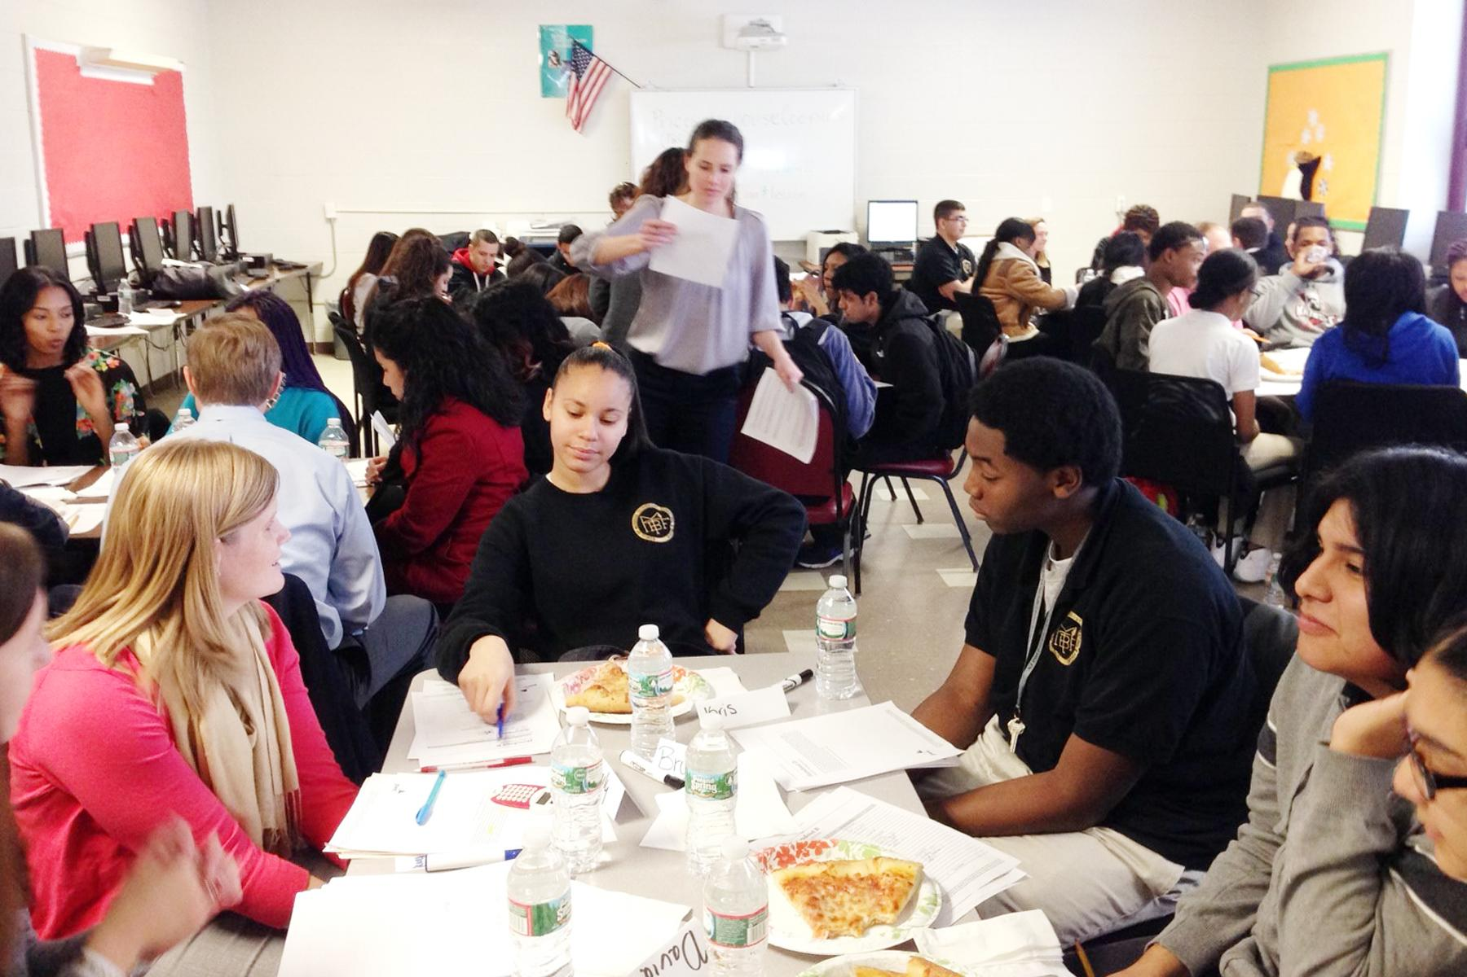

PwC Career Planning and Preparation
Our Accounting students attended 2 workshops on Careers hosted by Peter Nicolas and his team.

Slide 16

Marketing Pathway
Course offerings include:
Introduction to Marketing
Marketing I
Marketing II/Job Training (SLE)
*End of Program Assessment: A*S*K Fundamental Marketing Concepts
*Co Curricular Club: Distributive Education Clubs of America (DECA) *Marketing Application: Bright Knight Cafe
Notes:
We are currently re-writing the curricula for all 3 classes and collaborating more on methodically preparing students for the End of Program Assessment.
We are reinforcing the value of a higher level of performance that will earn students a certificate in Marketing Concepts and possible college credits
We are also better integrating DECA competitive assignments channel students writing and problem solving skills

Slide 17






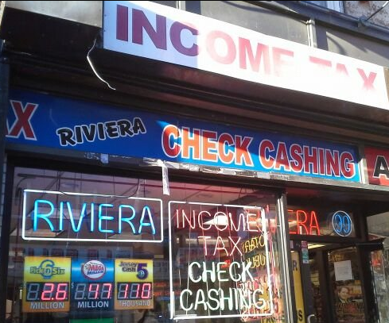




Marketing - Job Training

Slide 18
Marketing - Job Training - Lessons Learned
“I learned interviewing skills, how to set goals, how to be patient, be mature . . . and how to juggle a job and school.”
“I learned a lot about customer service at my job. I also learned about dealing with money and being faster at doing calculations.”
“I have learned that being responsible for your actions is a big part of being on your own.”

Slide 19
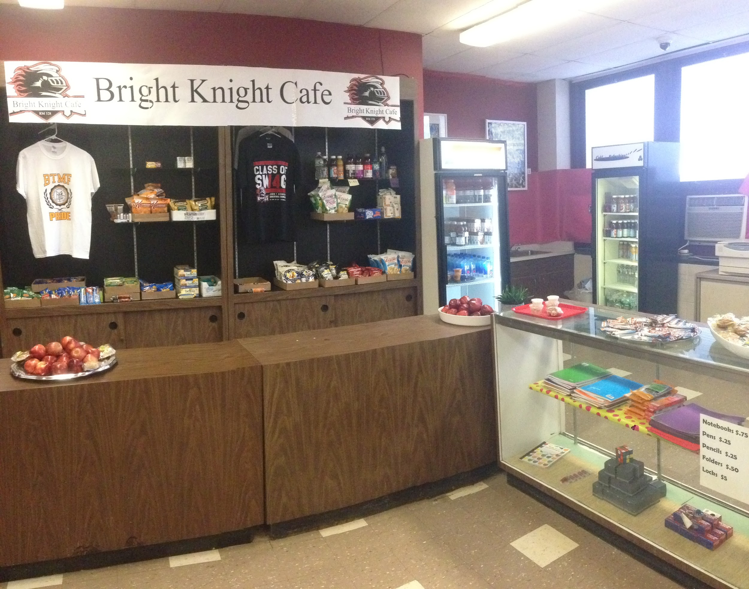
Bright Knight Cafe - Marketing Implementation
Provides uniforms, school supplies and healthy snacks
Promote healthy lifestyle related to diet, exercise and sleeping
Serves as working experience for students in Job Training Program
In transition to become a DECA certified School Based Enterprise
Marketing Students conduct Market Research, Launch New Products, Practice Effective Customer Service and Promote the cafe and build an online presence
Grand Opening Oct 28th, 2015
Notes:
Student Jobs next year are:
General Manager(s)
Assistant Manager(s)
Buyer(s)
Merchandising Manager
Advertising and Display Manage
E Marketer Manager
Accountant/Bookkeeper
Cashiers

Slide 20
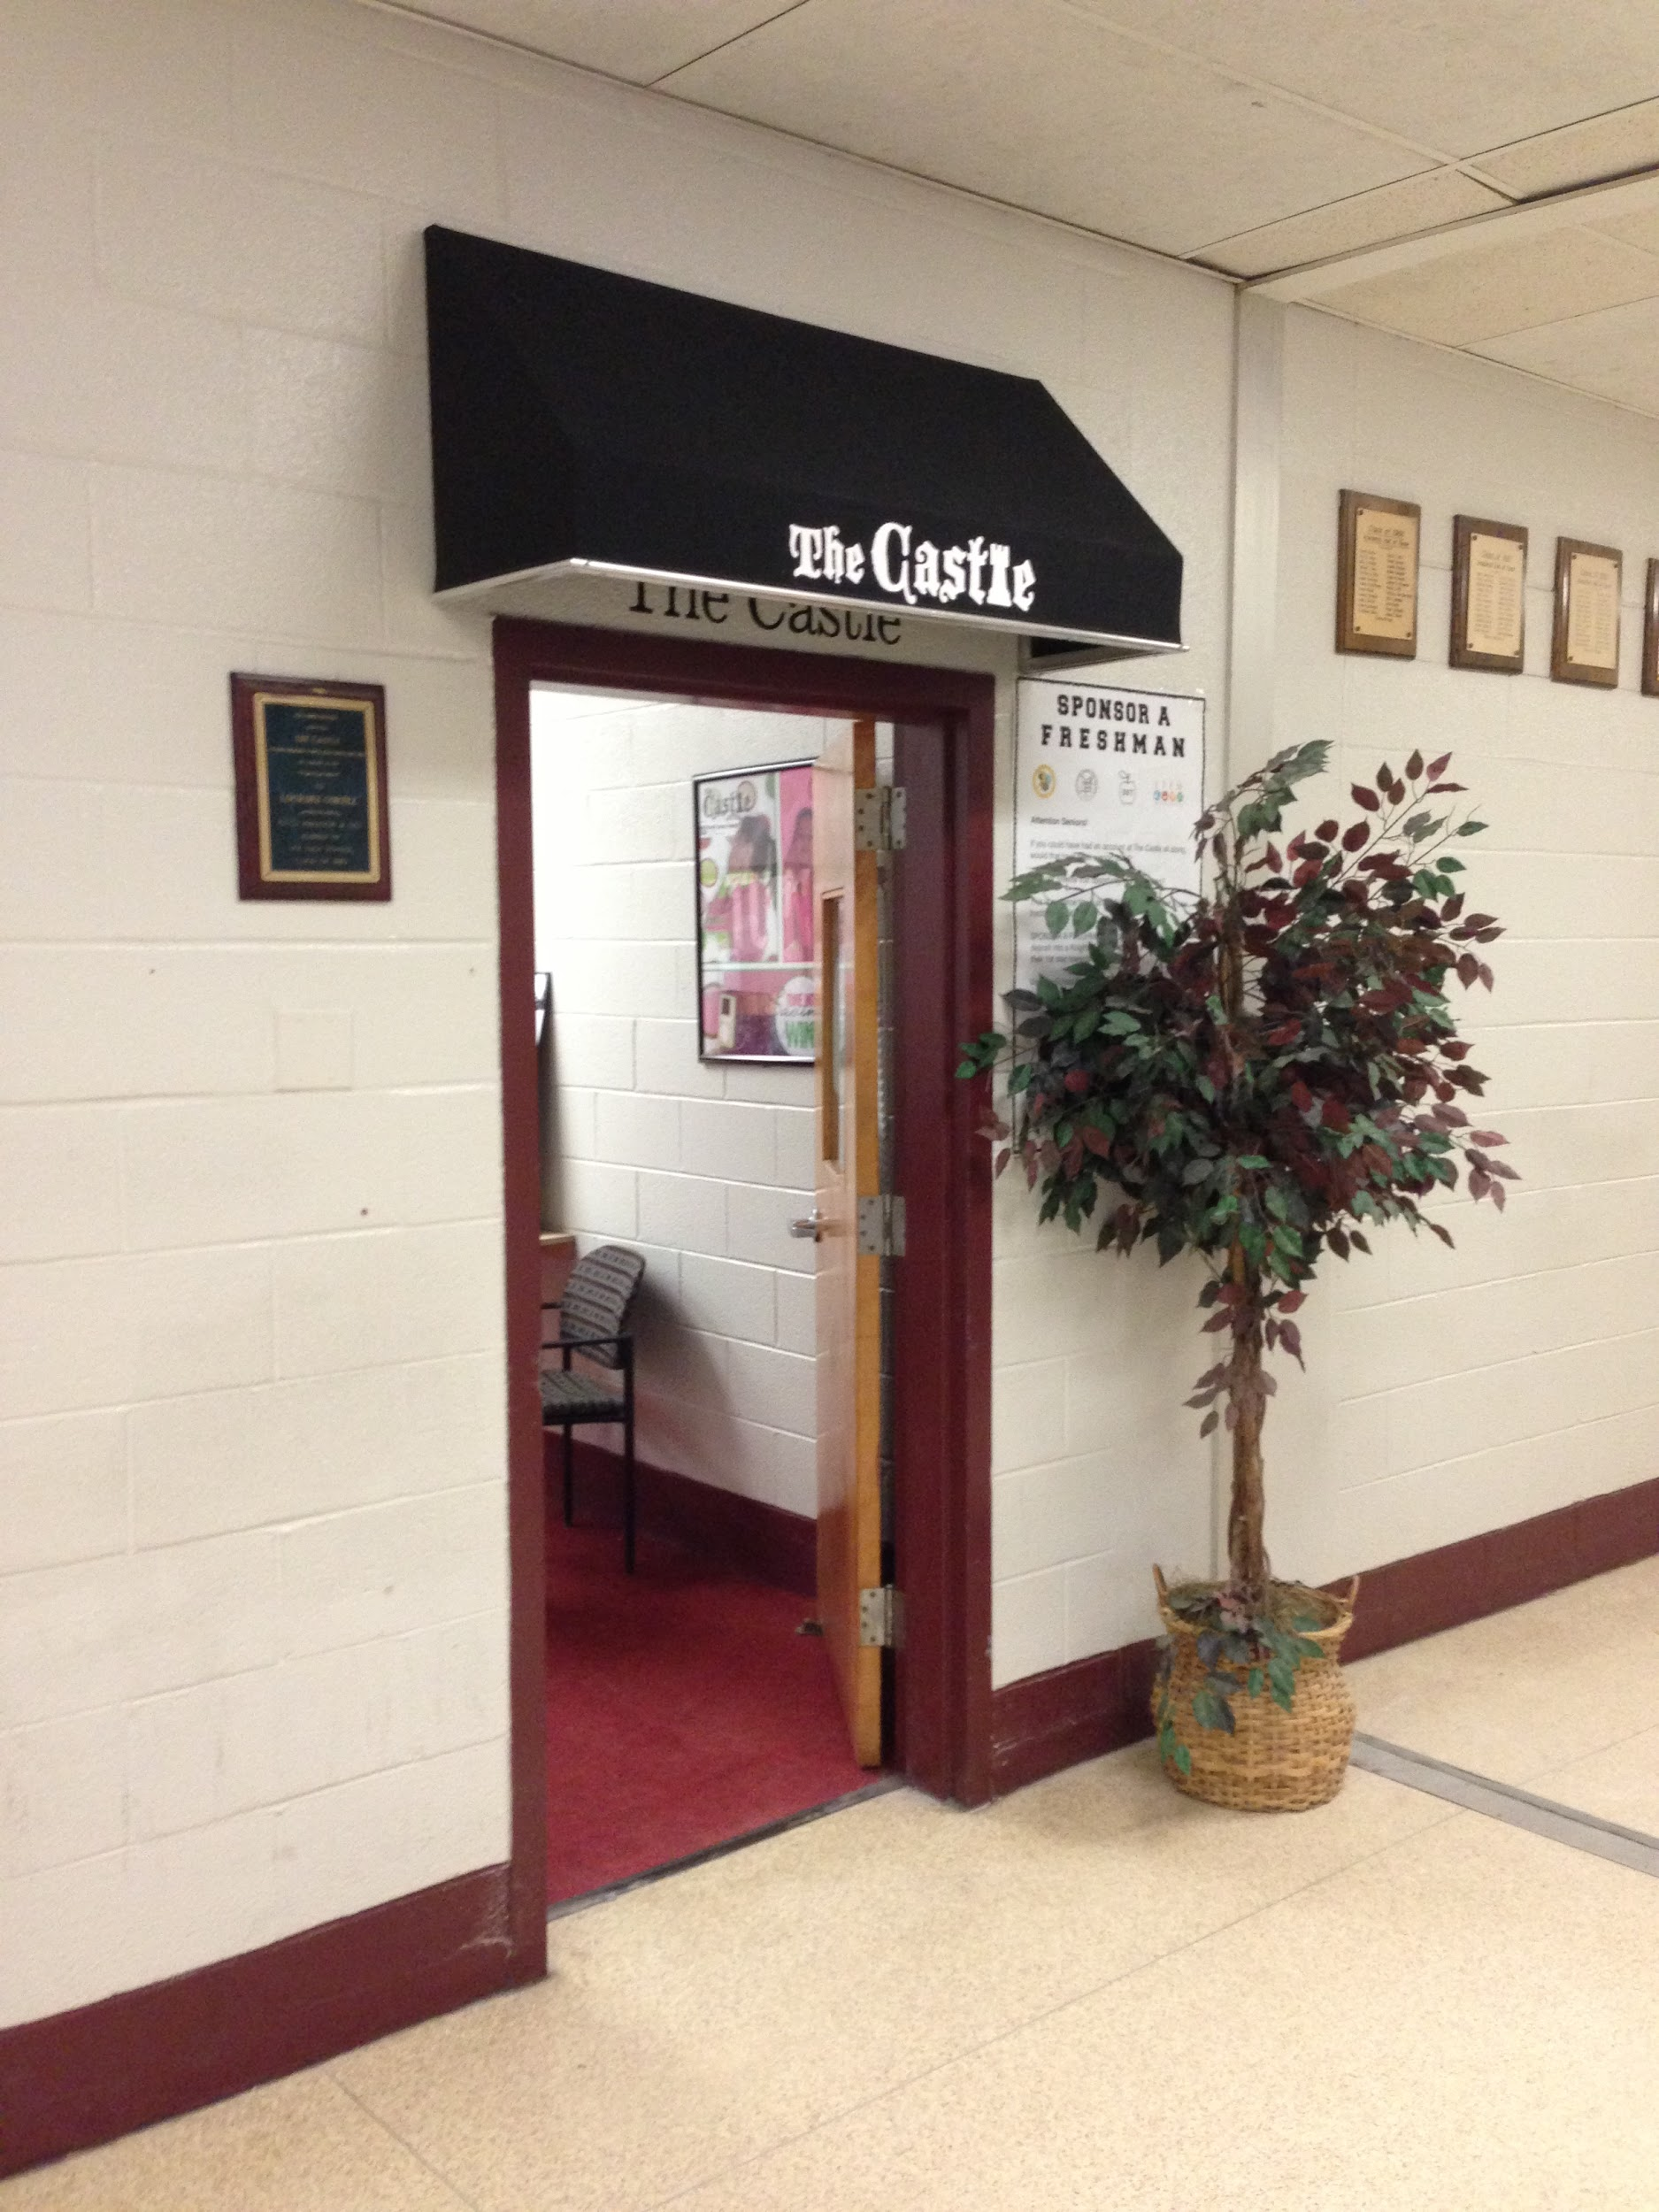

Banking, Finance, and Accounting
Course offerings include:
Banking and Finance
Accounting I
Accounting II
CASTLE Internship
Quickbooks Certification
Castle Internship Program - NJFCU

Slide 21
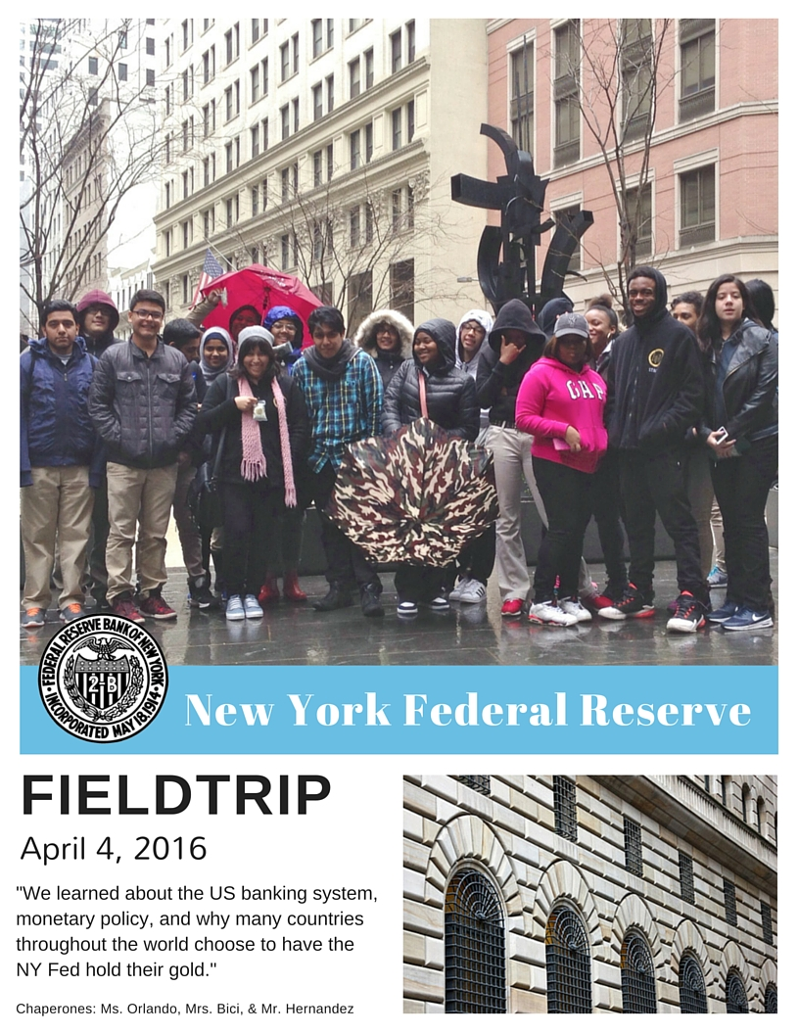

Slide 22

Information Technology Applications
Course offerings include:
Introduction to Word
Essentials of MOS
Business Administration and Management
End of Program Assessment: Microsoft Office Specialist
Co Curricular: Future Business Leaders of America (FBLA)
MOS Certification Data: Students to be Tested Spring 2016

Slide 23

Computerized Accounting I & II
This is our second year teaching QuickBooks.
Last year only Accounting II students were exposed to the accounting software.
This year, Accounting I students are using the software to complete assignments.
Accounting II students came in with a solid foundation of basic accounting. They were able to quickly apply what they learned in Accounting I to QB.
Twelve out of nineteen students achieved a passing score on the certification practice exam taken at the end of March, 2016.
Students are currently reviewing the weak areas and will take the second practice in early May with the goal of passing the exam by the end of the same month.
We are confident that more than half the class will become certified quickbooks user.

Slide 24
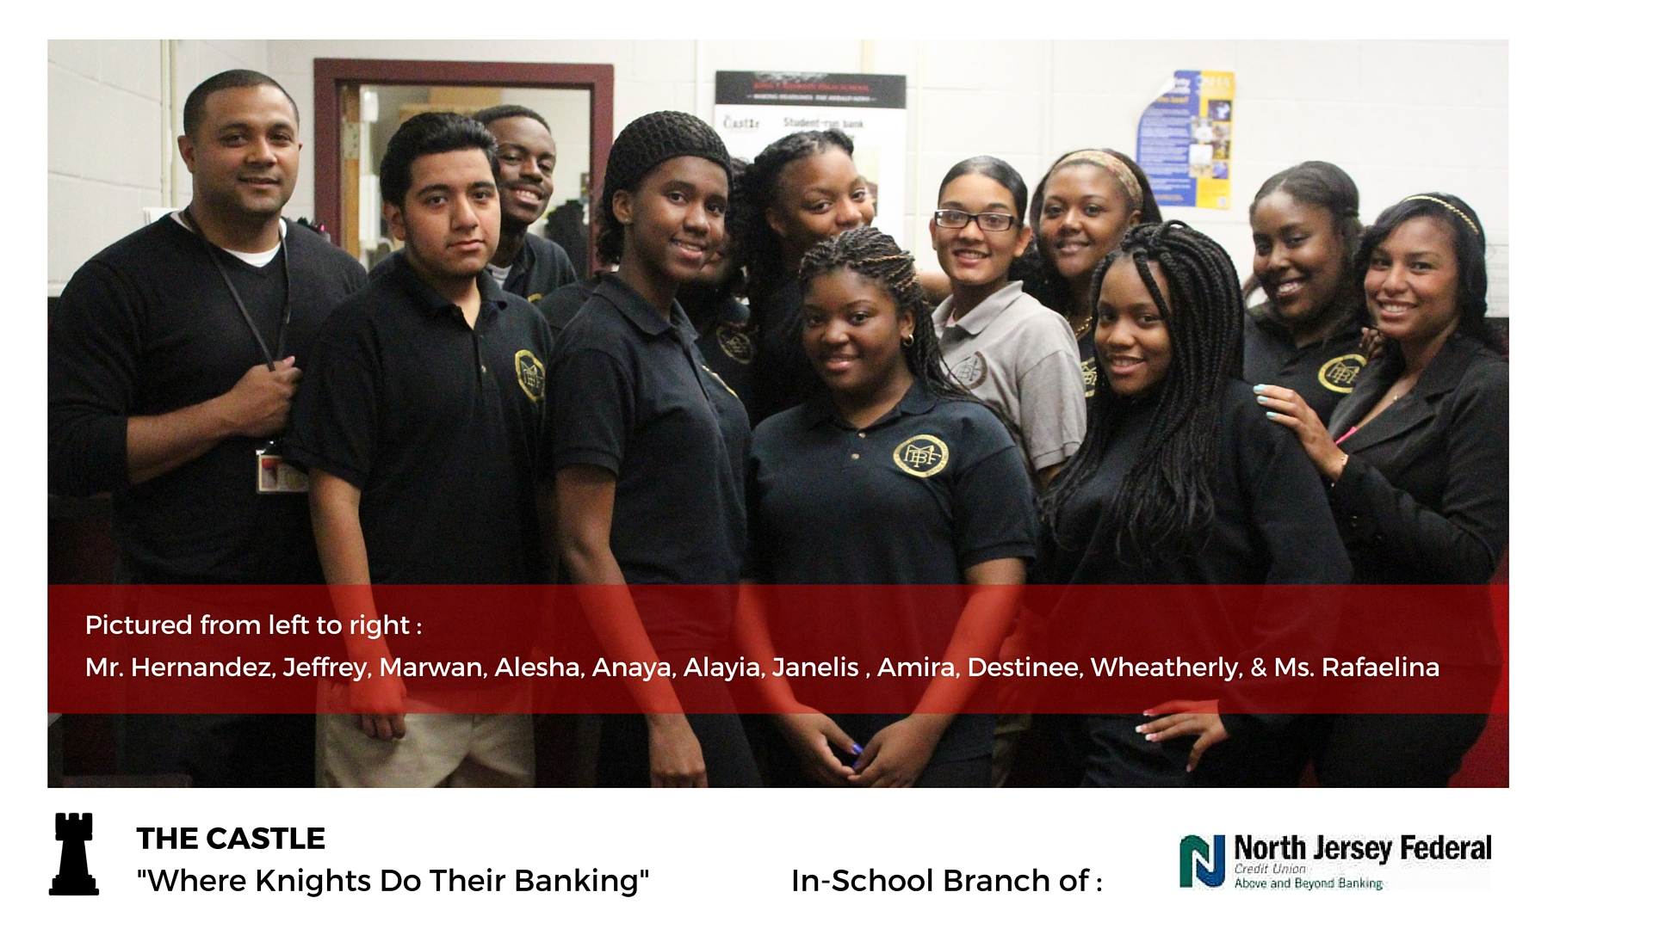

Insert Bar Graph- Hernandez
2015 - 2016 CASTLE TEAM
North Jersey Federal Credit Union

Slide 25
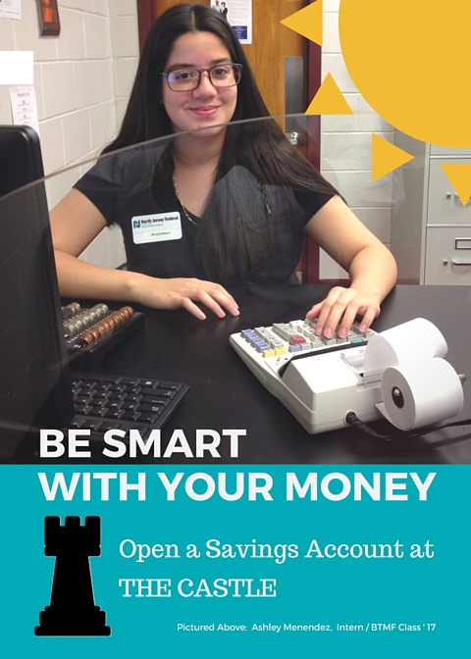
NJFCU CASTLE / Internship
is the in-school branch of North Jersey Federal Credit Union.
Students interns:
receive hands-on work experience as tellers
develop personal finance skills
participate in marketing campaigns to promote the branch’s services

Slide 26
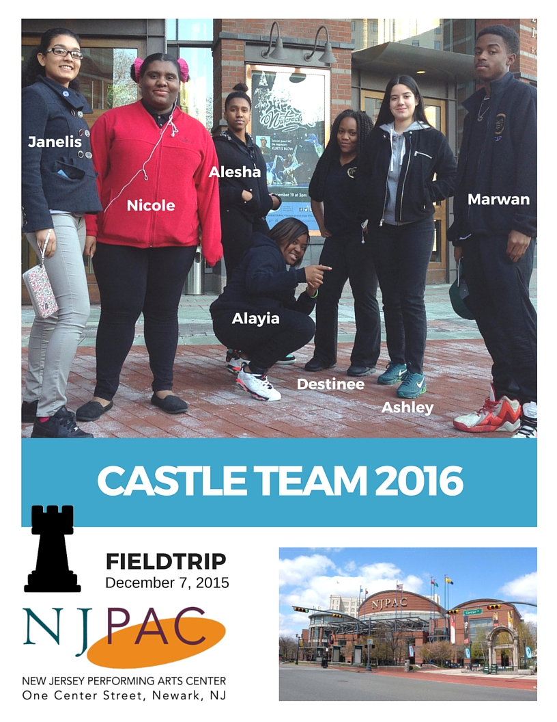

Slide 27
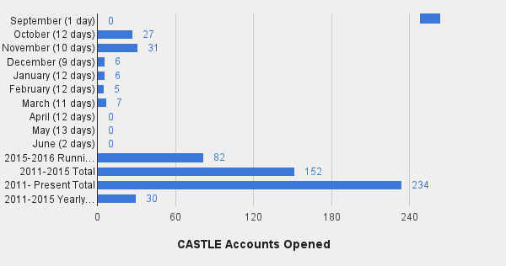
North Jersey Federal Credit Union

Slide 28

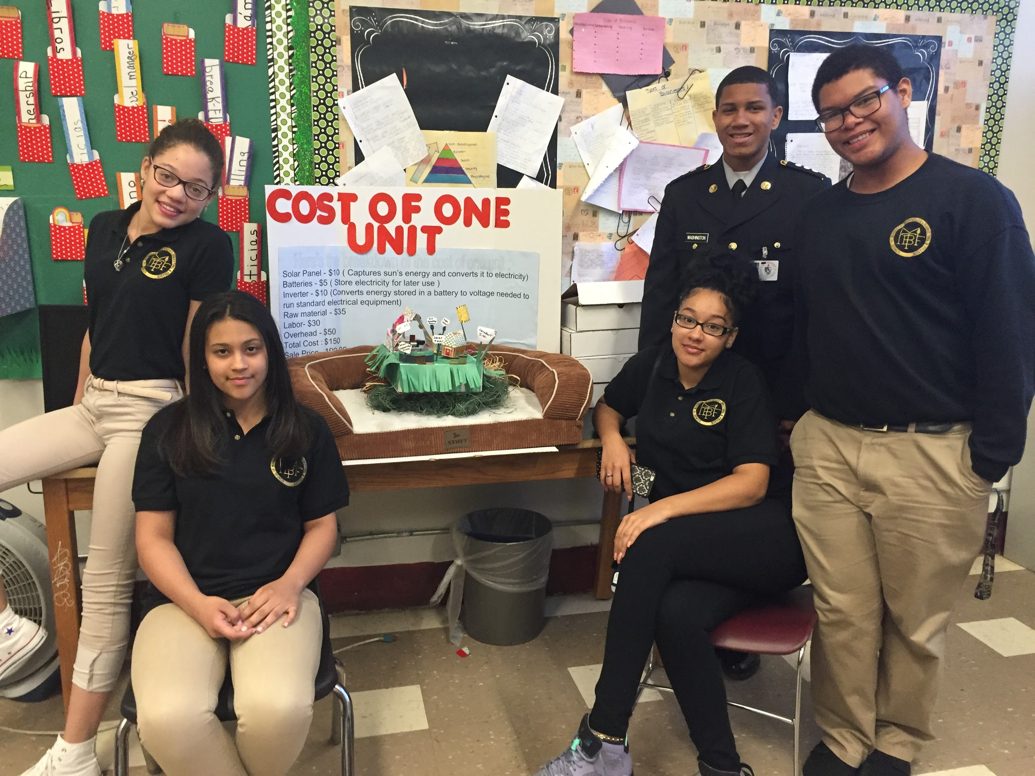
Day of Innovation on May 26, 2016

Slide 29

Junior Achievement - May 25, 2016
Junior Achievement provides students a real-world perspective of finance - one that is current, practical, and easy to understand. Junior Achievement has strengthened its commitment to area students by creating an experiential financial literacy center in the region (Edison, NJ).

Slide 30

The School of Business, Technology, Marketing and Finance thanks you for your valuable contributions through the year!
2015-2016 School Year

